Slide 1
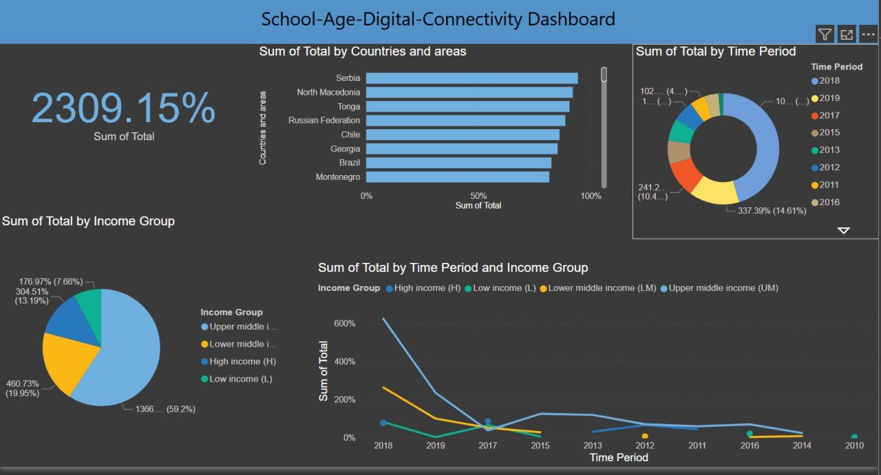
DASHBOARD WITH DIFFERENT CHARTS THAT WE USED

Slide 2
Recommended Chart Types and Their Justifications
Reasons;
a)Pie Chart
Use Case: Representing the proportion of school-age children who have digital connectivity versus those who don’t.
Showing distribution of digital access across income groups or wealth quintiles.
Comparing the share of urban vs. rural populations in digital connectivity.
Why Use a Pie Chart?
A pie chart is an effective visualization tool for showing relative proportions of a whole.
It helps to answer questions like:
How much of the total school-age population is connected to the internet?
What percentage of school-age children in different wealth quintiles have digital access?
What share of internet access is from urban vs. rural areas?
Design Principles for Pie Charts:
Proportional Representation (Accuracy & Clarity)
Each slice accurately represents the proportion of the category in relation to the whole.
Pie charts work best for 2–5 categories where the differences are significant.
2. Color Differentiation (Distinction & Readability)
Use contrasting colors to make each category visually distinct.
A darker shade for the largest segment helps direct attention to the most important insight.
3. Simplicity (Avoiding Overload & Enhancing Focus)
No more than 5 slices to prevent confusion
Direct labeling instead of using a legend to make the chart easier to interpret.

Slide 3
4. Order of Slices (Visual Flow & Understanding)
Arrange slices from largest to smallest in a clockwise direction to guide the viewer’s eyes naturally.
Place the most critical category at the 12 o’clock position for emphasis.
2. Card (For Key Summary Metrics)
Use Case: Highlighting important statistics in a clear, readable format.
Providing a high-level summary of key digital connectivity metrics.
Ensuring the audience quickly grasps the most critical insights before diving into detailed visualizations.
Why Use a Card?
A card (or metric box) is useful for displaying single, high-impact numbers that viewers can quickly absorb.
Cards help answer direct, data-driven questions like:
What is the total percentage of school-age children with internet access?
How many children in low-income regions have connectivity?
What is the urban vs. rural digital divide?
Design Principles for Cards:
Minimalism (Focus & Readability)
A card should contain only essential numbers.
Avoid extra text—keep it clean and concise.
2. Visual Hierarchy (Emphasis on Key Figures)
The most important number should be bold and large for instant recognition.
Supporting context (e.g., “Sum of Total”) should be smaller and secondary.

Slide 4
3. Stacked Bar Chart (For Proportions Within Categories)
Use Case: Visualizing the percentage of school-age children with digital connectivity within each wealth quintile or region.
Showing the distribution of digital connectivity by income group.
Why Stacked Bar Charts?
Shows both absolute values and proportions in one visualization.
Helps in understanding how wealth inequality affects digital access.
Design Principles to Considered:
Color Differentiation: Use distinct colors for each wealth quintile (e.g., poorest to richest).
Proportionality: Ensure bars add up to 100% for accurate interpretation.
Minimalism: Limit the number of wealth categories shown to avoid clutter.
Labeling: Use direct labels instead of a legend to make it easy to read.
4. Donut Chart (For Showing Overall Proportions)
Use Case: Showing the sum of total vs Time period.
Why Donut Charts?
Provides a high-level overview of proportions.
More visually appealing than a pie chart due to its center space (which can contain total values).
Design Principles to Considered:
Limited Categories: No more than 8 segments to avoid misinterpretation.
Highlighting Key Insights: The largest segment should be emphasized with a slightly darker shade.
Center Labeling: Display the total percentage of school-age children connected.

Slide 5
5. Line Chart (For Showing Trends Over Time)
Use Case:Tracking changes in digital connectivity over multiple years (if time-series data is available).
Why Line Charts?
Best for showing patterns, trends, and seasonality over time.
Helps identify gradual improvements or sharp declines in connectivity.
Design Principles to Considered:
Continuity: Ensure smooth transitions between years.
Highlighting Key Points: Use markers to emphasize major shifts (e.g., a policy change in a specific year).
Multiple Lines: Use separate lines for urban vs. rural populations to compare growth rates.

Slide 6
Best practices ;
1)pie chart
a.Keep the number of slices limited to maintain clarity - we used a total of 5 slices to represent the sum of total income group,thus maintaining clarity by limiting slices.
b. Clearly label each slice with clear text - we used percentages to label each slice according to the total, with a clear concise key to illustrate what each slice represents.
c. Ensure consistency so that viewers can associate colour with specific categories - we used bright and vibrant colours that are easily noticeable and making it a powerful aid in attracting attention.
2) line chart
a.Ensure that data you are representing has a logical order - we used logical order where the time period was following consistent years and the sum of total has equal interval of percentage.
b. Add context through annotations and labels - we added more context to the line chart through keys that clearly explain what each colour is representing. Clear labels in the title,x and y axis were used,thus readers can easily interpret what the line chart is representing trend between what categories.
c. If the dataset it large,we use transparency or spacing to improve visibility - we used spacing since the dataset represented happens to be large,hence improving visibility.
3) stacked bar chart
a)Use logical ordering (descending order) -We used logical ordering where the sum of total in countries was in descending order,with serbia leading.
b) Clearly labeled axis with concise labels-We used clearly labeled axis with concise labels,with easier understanding at first glance,that we are comparing sum of total by countries and areas, and in percentage format.
c) Keep it simple -We kept it simple by limiting the number of categories we used to avoid cluttering.
d) Purposely use color to highlight and convey meaning -We used color blue that is eye catching for adjacent segments.

Slide 7
d) Donut
Purposely use distinct color -We used consistent distinct colors for each segment, that makes it easier to highlight each segment.
Ensure proper ordering -We used proper ordering by sorting segments by size from the largest to the smallest in a clockwise way from 2012 having the largest segment.
Label clearly - We used clear labels that show what each color represents absolute percentage values near segments.
Avoid 3D effects -We avoided using 3D effects and settled for a flat design to represent distortion and misinterpretation of segment sizes.
e) Card
Focus on single key metrics -We focused on a single key metric, where we displayed the percentage of the sum of total of the dataset.
Use clear and large fonts-We used clear, bold and prominence on the main number for quick reading ability, thus it's easier to spot and see conclusions.

